Slide 1
Homogeneity In Ejecta Velocity Of Type Ia Supernovae
Toby Heller

Slide 2
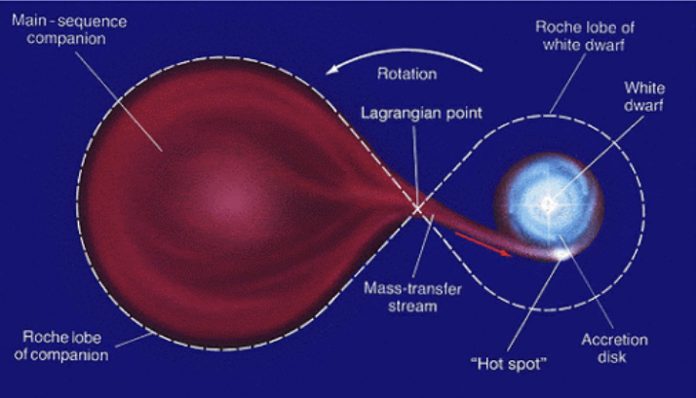

What is a Type Ia Supernova?
Subset of supernovae caused by the accumulation of matter by a white dwarf in a binary system
When the white dwarf exceeds the Chandrasekhar limit (${\sim 1.44M}_{⊙}$), it triggers a fusion reaction
$M_{v}≈−19.3$

Slide 3
Research Questions
What shape does the distribution of ejecta velocities take (e.g. Gaussian, bimodal, etc.)?
To what extent are the velocities uniform?

Slide 4
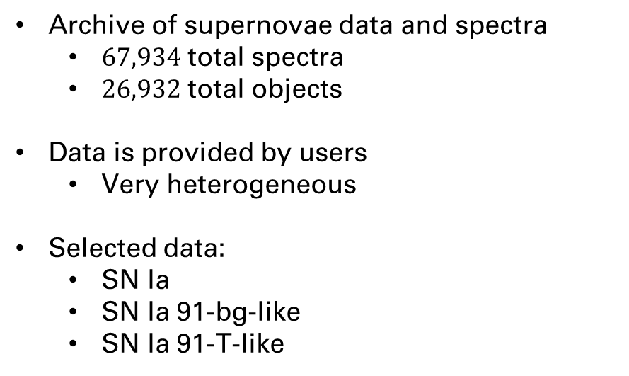
Data: WISeREP
Weizmann Interactive Supernova Data Repository
Archive of supernovae data and spectra
$67,934$ total spectra
$26,932$ total objects
Data is provided by users
Very heterogeneous
Selected data:
SN Ia
SN Ia 91-bg-like
SN Ia 91-T-like

Slide 5

Plan
Select data
Calculate metadata
Filter data using metadata
Normalize all data to $z_{progenitor}=0$
Normalize flux around Si II emission line $≈6356Å$
Find Si II absorption line
Fit

